Slide 1


VISVESVARAYA TECHNOLOGICAL UNIVERSITY
DAYANANDA SAGAR COLLEGE OF ENGINEERING
Department of Electronics and Telecommunication Engineering
FINGERPRINT BASED FRAUD DETECTION VOTING SYSTEM
Submitted by:
Aditi S Kumar 1DS19ET003
Aishwarya 1DS19ET004
Pavan Parameshwar 1DS19ET055
Sphoorthi S M 1DS19ET087
Guided by:
Dr. Vinod B Durdi
(Associate professor)

Slide 2
Contents
Introduction
Problem Statement
Objective of the Project
Literature Survey
Block Diagram
Methodology
Flow chart
Hardware and Software Requirements
Present work
Project Outcomes
Conclusion and Future Work
References

Slide 3
Introduction
Biometrics is the science and technology of measuring and analyzing biological data. Biometrics refers to technologies that measure and analyze human body characteristics, such as DNA, fingerprints, eye retinas and irises, voice patterns, facial patterns and hand measurements, for authentication purposes.
The field of biometrics was formed and has since expanded on to many types of physical identification. Among the several, human fingerprints remain a very common identifier and the biometric method of choice among law enforcement. These concepts of human identification have led to the development of fingerprint scanners that serve to quickly identify individuals and assign access privileges.

Slide 4
The basic point of these devices is also to examine the fingerprint data of an individual and compare it to a database of other fingerprints. In our project we have used fingerprints for the purpose of voter identification or authentication. As the thumb impression of every individual is unique, it helps in minimizing the error.
A database is created containing the fingerprint images of all the voters as required. Illegal votes and repetition of votes is checked for in this system with accurate coding. Hence with the application of this fingerprint based EVM, system elections could be made fair and free from rigging. Further that the elections would no longer be a tedious and expensive job.

Slide 5
Problem Statement
The current voting system in India is slow and vulnerable in the authentication of voters, where the only thing that the security checks is a voter ID card, which these days are faked by many.
Identity verifications are done manually which requires more manpower. In the present system there must be people assigned to check whether EVM’s are busy or not.
This process is slow and counting the votes manually can take a long time.

Slide 6
Objective of the project
The possible solution is, if a person is identified using his/her fingerprint rules out the possibility of fake votes and also it provides the result immediately after the voting process is completed. The whole process is done automatically by the voting machine.
The environment of this voting system is designed in such a way that it won't allow voters inside the voting room if another voter is casting his vote.

Slide 7
Literature Survey
Author(s) | Title | Year of Publication | Concepts covered
Rudrappa B, Shivaram N, Murughendra S, Shanta Reddy, Sangameshwar Neelagund | A Fingerprint based Voting System | May, 2015 (IJERT) | Fingerprint sensor, its working, its usage in fraud detection.
Khadija Hasta, Aditya Date, Aparna Shrivastava, Prajakta Jhade, S.N. Shelke | Fingerprint based Secured Voting | 2019(ICAC3) | Working of the system with the domain as IoT using Arduino.
Mohammad Malkawi, Omar Al-Jarrah,Thaier S. Hayajneh, Munzar S.Ebaid | A biometric-secure e-voting system for election processes | 2008 | Storage of fingerprints in a database, transparency involved with immediate intimation of the vote casted.

Slide 8
Author(s) | Title | Year of Publication | Concepts covered
Parikshit Martolia,Pragati Bhojak, Sneha Bisht, Ajeet Singh | Study of Biometric Voting System | 2017 | Feeding data using fingerprint sensor.

Slide 9
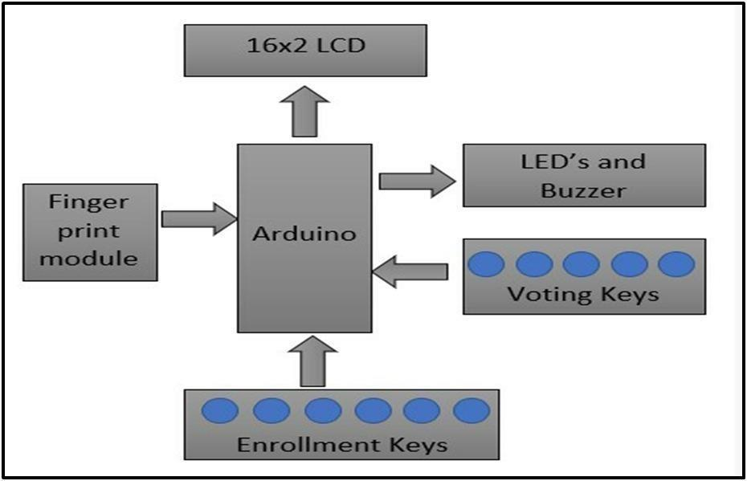
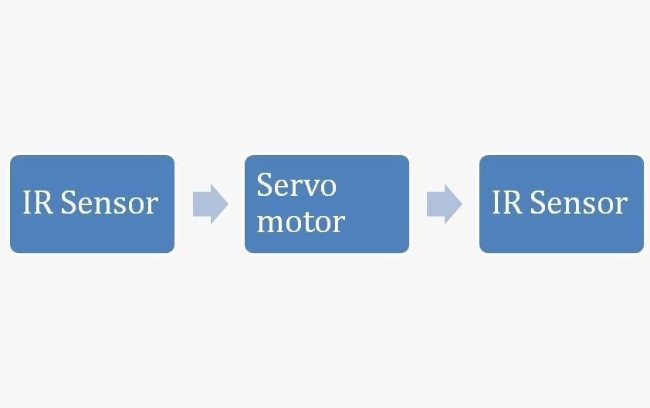
Block Diagram of Fingerprint Based Fraud Detection System
Block Diagram of the given Implementation

Slide 10
Methodology
Before casting the vote, a voter must register his fingerprint in order to verify his vote is a valid one or not.
After registering the fingerprints of different voters, the voting process is conducted further.
Voters upon arriving at the ballot stations will form a queue outside the entry gate controlled by a servo motor.
An IR sensor is utilized to detect the movement of the voters in order to allow only one voter at a time into the ballot room.
The voter enters the ballot room, places his fingerprint on the fingerprint module in order to identify his details and if it matches with the details given during registration, he is further allowed to cast his vote.

Slide 11
Methodology
Candidate options are given to the voter and he is allowed to vote for the candidate whom he decides to cast his vote for.
Further after completion of casting the vote he arrives near the exit gate, where an IR sensor is placed in order to detect the exit of the voter.
Only after the voter has passed the second IR sensor, the first IR sensor is allowed to open the gate upon detecting movement near the entry gate, allowing only one person into the ballot room.

Slide 12
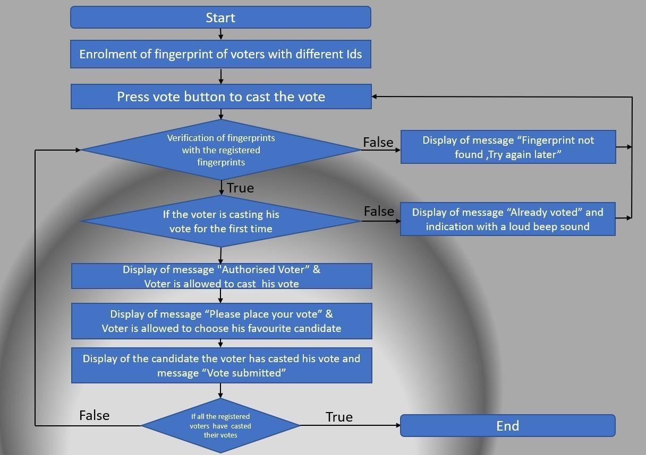
Flow Chart of the Implementation

Slide 13
Hardware and Software Requirements
Hardware used: Arduino UNO (for Implementing gate system)
Arduino Nano (for Implementing Voting count system)
R305 Fingerprint Sensor
SG90 Gate Sensor
Generic IR Sensor
Software used for coding: Arduino IDE
Programming Language used: Embedded C Language

Slide 14
Present Work
We designed a system by placing components like LCD display and Arduino nano and a total of 8 push buttons being inserted on them.
A Finger Print Sensor Module(R-305) is implemented for authentication of true voter by taking their finger input in the system. After which three push buttons of the total 8 were used – 2 of them for the candidates and one for the result.
Fingerprint module’s Rx and Tx directly connected at Serial pin Tx and Rx of Arduino. 5v supply is used for powering finger print module taken from Arduino board.
An IR Sensor and a Servo Motor have been used to ensure that only one person is present in the ballot room to cast his vote.

Slide 15
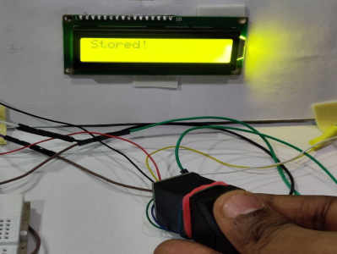
Project Outcomes
In this project we have LCD to indicate the status of the voting process.
STEP 1:
Adding fingerprints of the voters to the database.

Slide 16
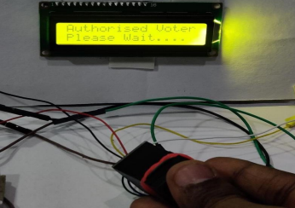
STEP 2:
The voter's identity will be checked by the fingerprints before casting votes.
CASE1: If the voter has enrolled before casting his vote

Slide 17
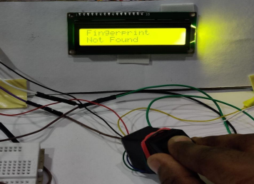
CASE2: If the voter has not enrolled before casting his vote

Slide 18
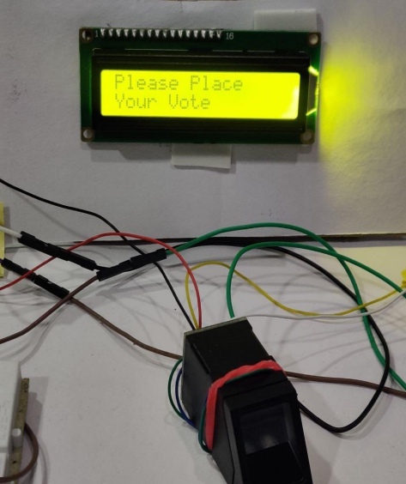
STEP 3: Voting Process
CASE 1:
Voter comes to the booth to cast his vote for the first time in that election.

Slide 19
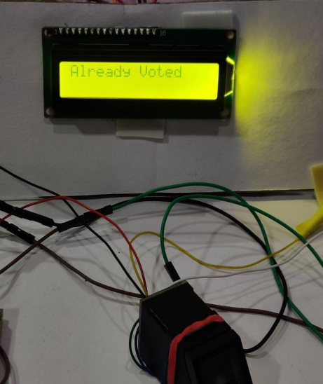
CASE 2: Voter comes to the booth to cast his vote for the second time in that election.

Slide 20
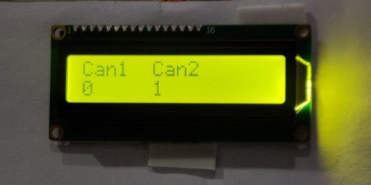
STEP 4: Instantaneous results are displayed upon verifying Admin’s fingerprint

Slide 21
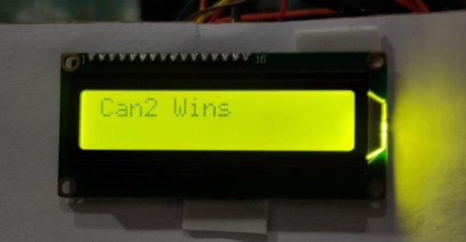

Slide 22
Conclusion
The project “Fingerprint Based Fraud Detection voting system” was mainly intended to develop a fingerprint based advanced Electronic Voting Machine (EVM) which helps in free and fair way of conducting elections which are basis for democratic countries like India.
The integration of biometric authentication within the system will provide an efficient way to cast votes, free of fraud, and make the system more trustable, economic and fast as well as enabling the voters to cast their votes from any location as a result of the online voting module which can be accessed from any device with internet connectivity.

Slide 23
Future Work
In future works, this framework can be enhanced by including different applications. For Example, This project can be improvised further by accessing the Aadhaar card details which will provide their fingerprints instead of enrollment of their fingerprint before going to cast their vote.

Slide 24
References
Rudrappa B. Gujanatti1 , Shivaram N. Tolanur2 ,Murughendra S. Nemagoud3 , Shanta S. Reddy4 , Sangameshwar Neelagund5 , Assistant Professor1 ,Electronics and Communication Department K. L. E. Dr. MSSCET, Belgaum, India1,2,3,4,5, International Journal of Engineering Research & Technology (IJERT) ISSN: 2278-0181 IJERTV4IS050948, Vol. 4 Issue 05, May2015 -“A Finger Print based Voting System”. Available:https://www.ijert.org/research/a-finger-print-based-voting-system-IJERTV4IS050948
Khadija Hasta1 ,Aditya Date2 ,Aparna Shrivastava3 ,Prajakta Jhade4 , S. N. Shelke5 , Computer Engineering (SPPU), Pune, India1,2,3,4,5 , Published in 2019 International Conference on Advances in Computing, Communication and Control (ICAC3). -“Fingerprint Based Secured Voting”. Available:https://ieeexplore.ieee.org/document/9036777

Slide 25
Mohammed Khasawneh1 ,Mohammad Malkawi2 ,Omar Al-Jarrah3 ,Laith Barakat4 ,Thaier S. Hayajneh5 ,Munzer.S.Ebaid6 , College of Engineering, University of Illinois, UrbanaChampaign, Urbana,IL,USA1 ,AIM Wireless2 , Jordan University of Science and Technology, Irbid, Jordan3,4 , School of Information Systems, University of Pittsburgh, Pittsburgh, PA, USA5 , King Abdullah II Design and Development Bureau, Amman, Jordan6 , Published in 2008 5th International Symposium on Mechatronics and Its Applications -“A biometric-secure e-voting system for election processes”. Available:https://ieeexplore.ieee.org/document/4648818
Oluwatosin Adesua, University of Ibadan, March 2015, Thesis for: B.Sc. (Hons) -“Online voting system with biometric authentication for ui elections”. Available:https://www.researchgate.net/publication/310597883 ONLINE VOTING SYSTEM WITH BIOMETRIC AUTHENTICATION FOR UI ELECTIONS

